Slide 1
CLASS 4 – 11.16.2021
Player Analytics – Major League Baseball (MLB)
Assignment #3 – Due Nov. 28 | Individual
Final – Available Nov. 23 – Due Dec. 11 | Group
Guest Speaker:
Drew Bentley, Sr. Director, Business Strategy & Analytics, D.C. United
Breaks: 5:30pm (5 mins) | 6:05pm (10 mins)
Next 2 weeks – VIRTUAL CLASS VIA ZOOM

Slide 2
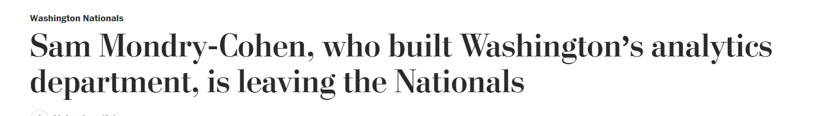
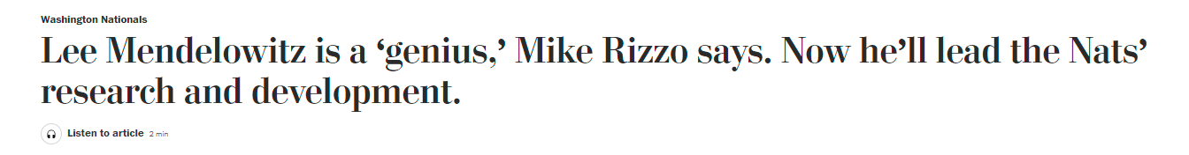
Sam Mondry-Cohen, an assistant general manager for the Washington Nationals, informed the club he will not return after his contract expires at the end of this season. Mondry-Cohen, 34, has been with the Nationals since 2009, when he began as an intern, and is responsible for building the organization’s research and development department.
In 2020, right after winning the World Series, the Nationals employed 12 people in the R&D department. Before the 2021 season, because of pandemic layoffs, that was slimmed to 10. Ted López, a developer, landed with the Tampa Bay Rays. Saul Forman was hired by the Philadelphia Phillies as a clubhouse analyst. Then Isaac Gerhart-Hines, director of software development, left the Nationals in the summer; Scott Van Lenten, a senior analyst, was poached by the Colorado Rockies to run their R&D operation; and Mondry-Cohen informed Rizzo of his plans in mid-September. Gerhart-Hines has since joined Van Lenten in Colorado. Mondry-Cohen is still searching for his next executive-level opportunity. Even before these departures, the Washington R&D team was dwarfed by those of baseball’s more progressive clubs.

Slide 3
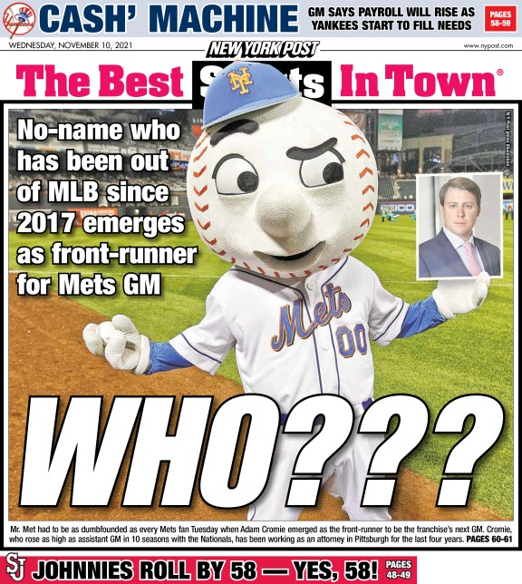
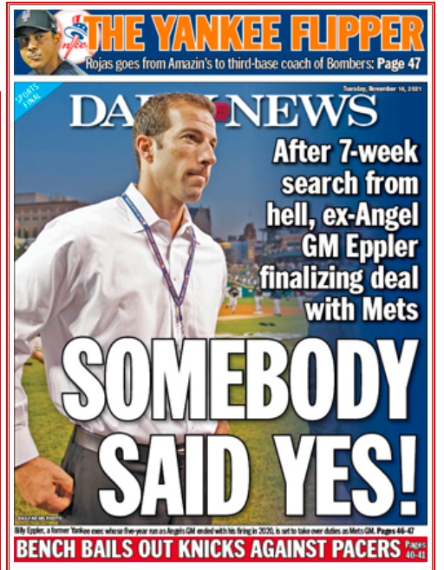

Slide 4
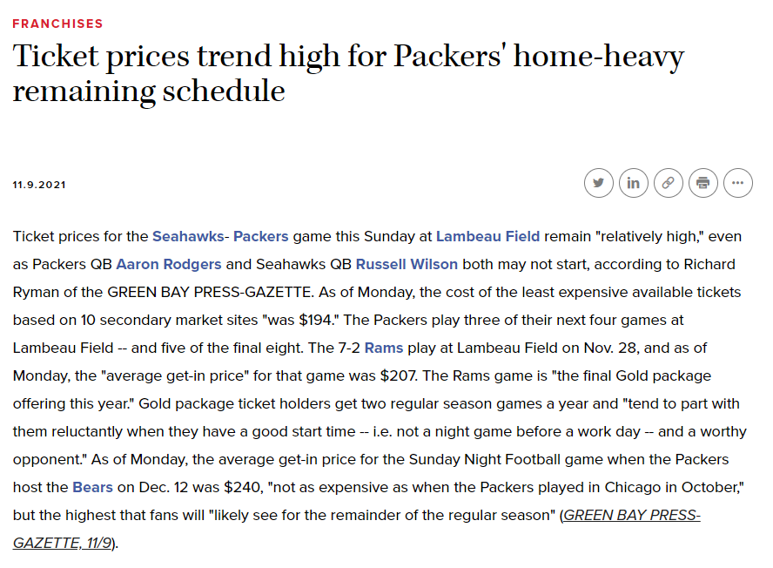
Trends over the past week
Notes:
https://www.sportsbusinessdaily.com/Daily/Issues/2019/11/14/Colleges/Notre-Dame.aspx

Slide 5
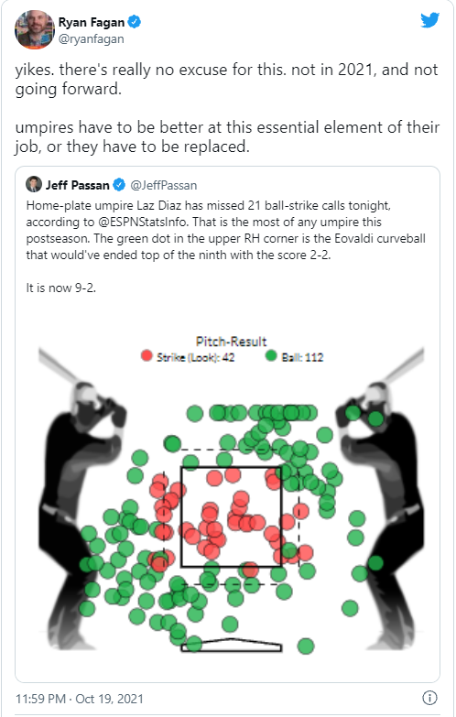
Notes:
http://www.sportsbusinessdaily.com/Daily/Issues/2017/11/15/Franchises/Packers.aspx?ana=SBD%20Email

Slide 6
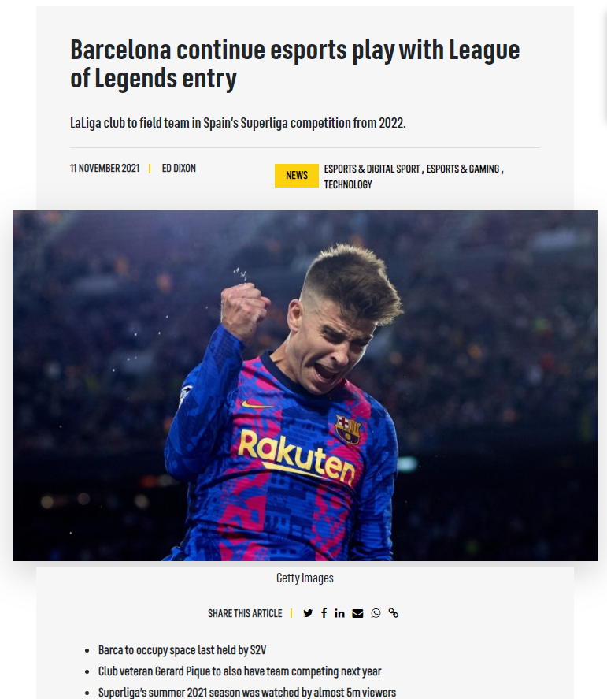
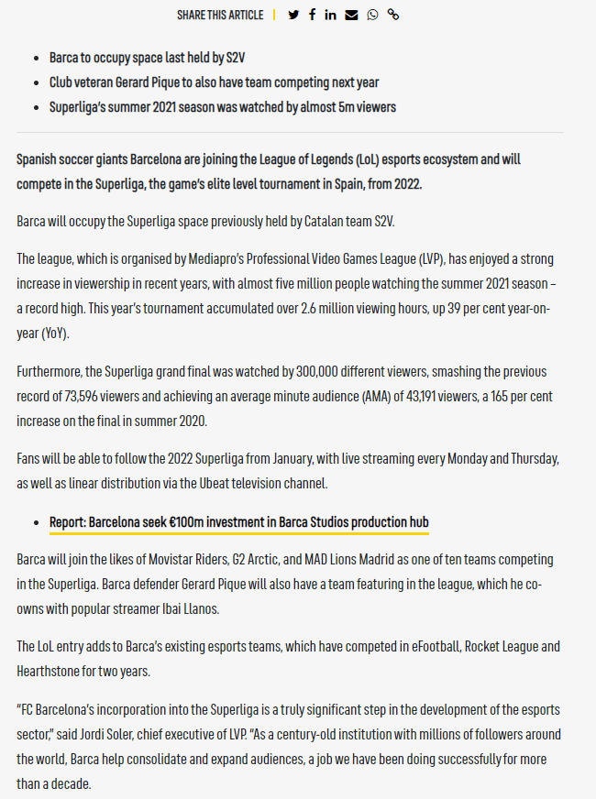
Notes:
https://www.sportspromedia.com/news/barcelona-league-of-legends-team-superliga-esports-gerard-pique/

Slide 7
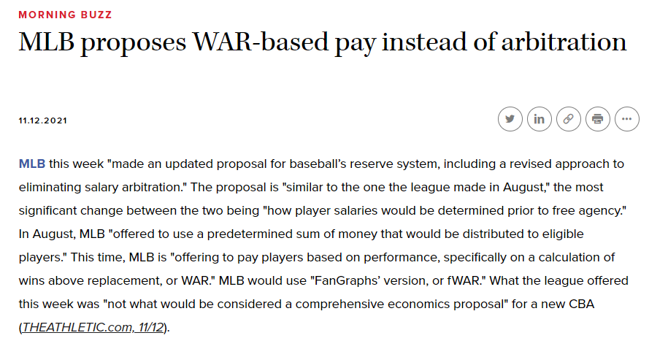
Notes:
https://www.sportsbusinessjournal.com/Daily/Morning-Buzz/2021/11/12/MLB.aspx

Slide 8
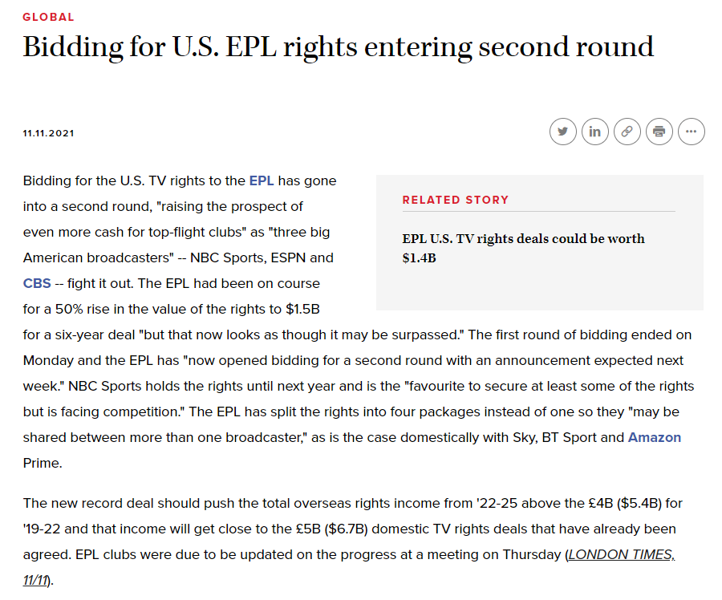

Slide 9
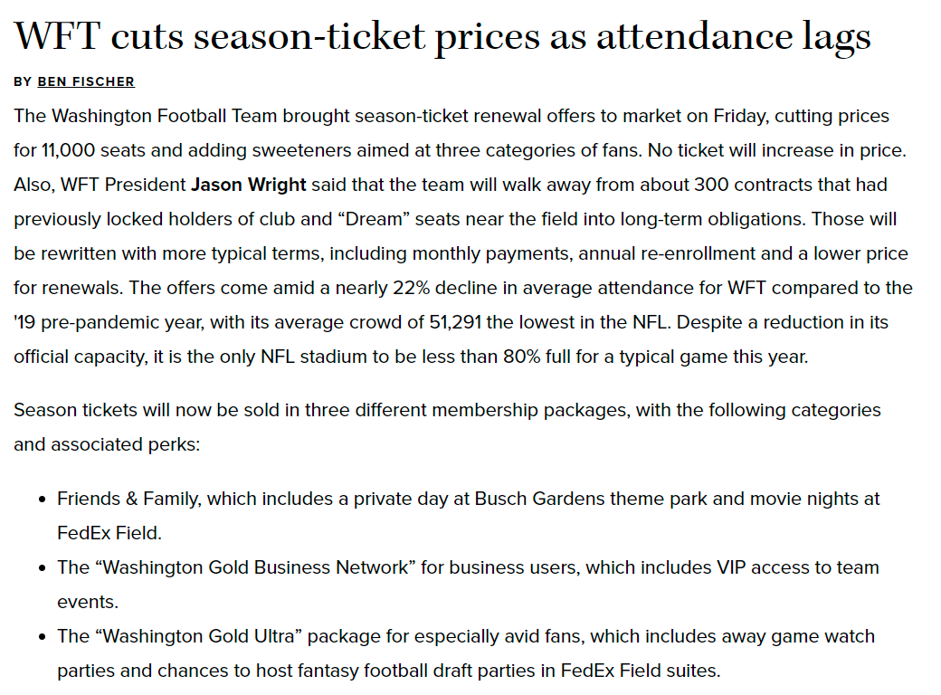

Slide 10
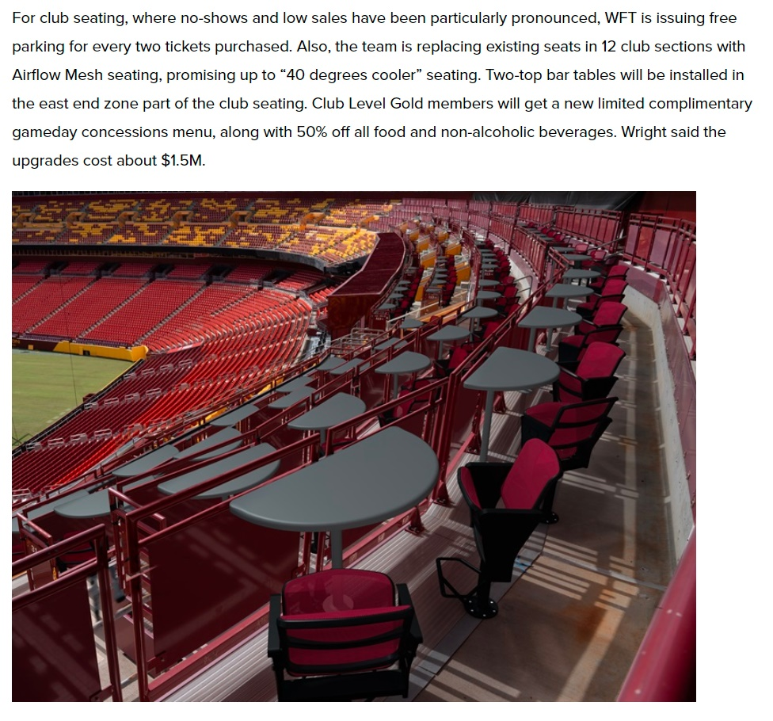

Slide 11
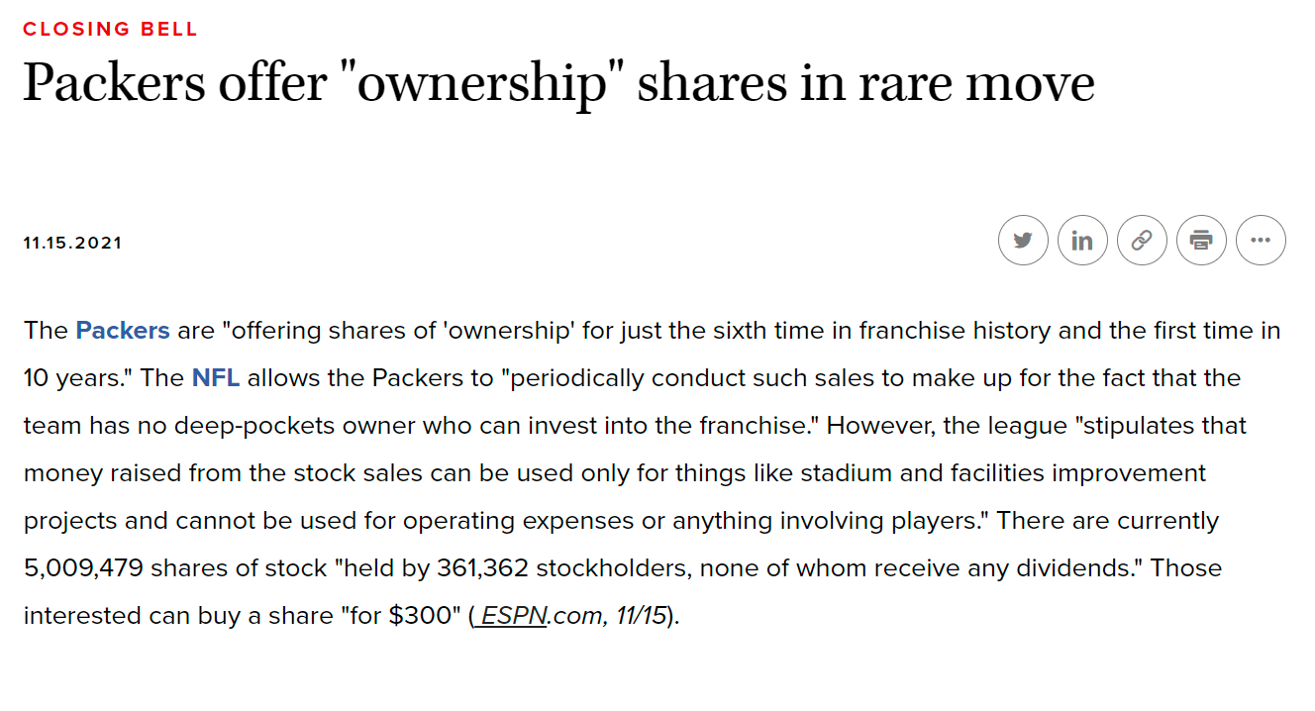

Slide 12


Slide 13

Notes:
https://www.altmansolon.com/insights/us-euro-sports-survey-spotlight/

Slide 14
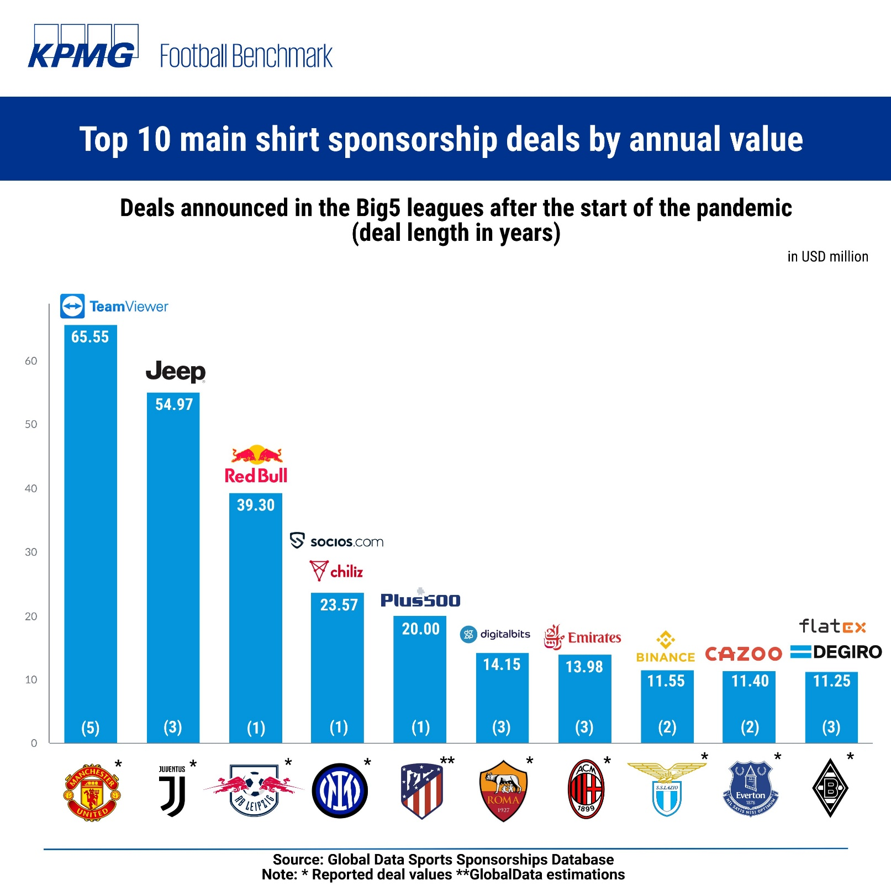
Notes:
https://twitter.com/Football_BM
https://twitter.com/Football_BM/status/1458028105386401795/photo/1

Slide 15
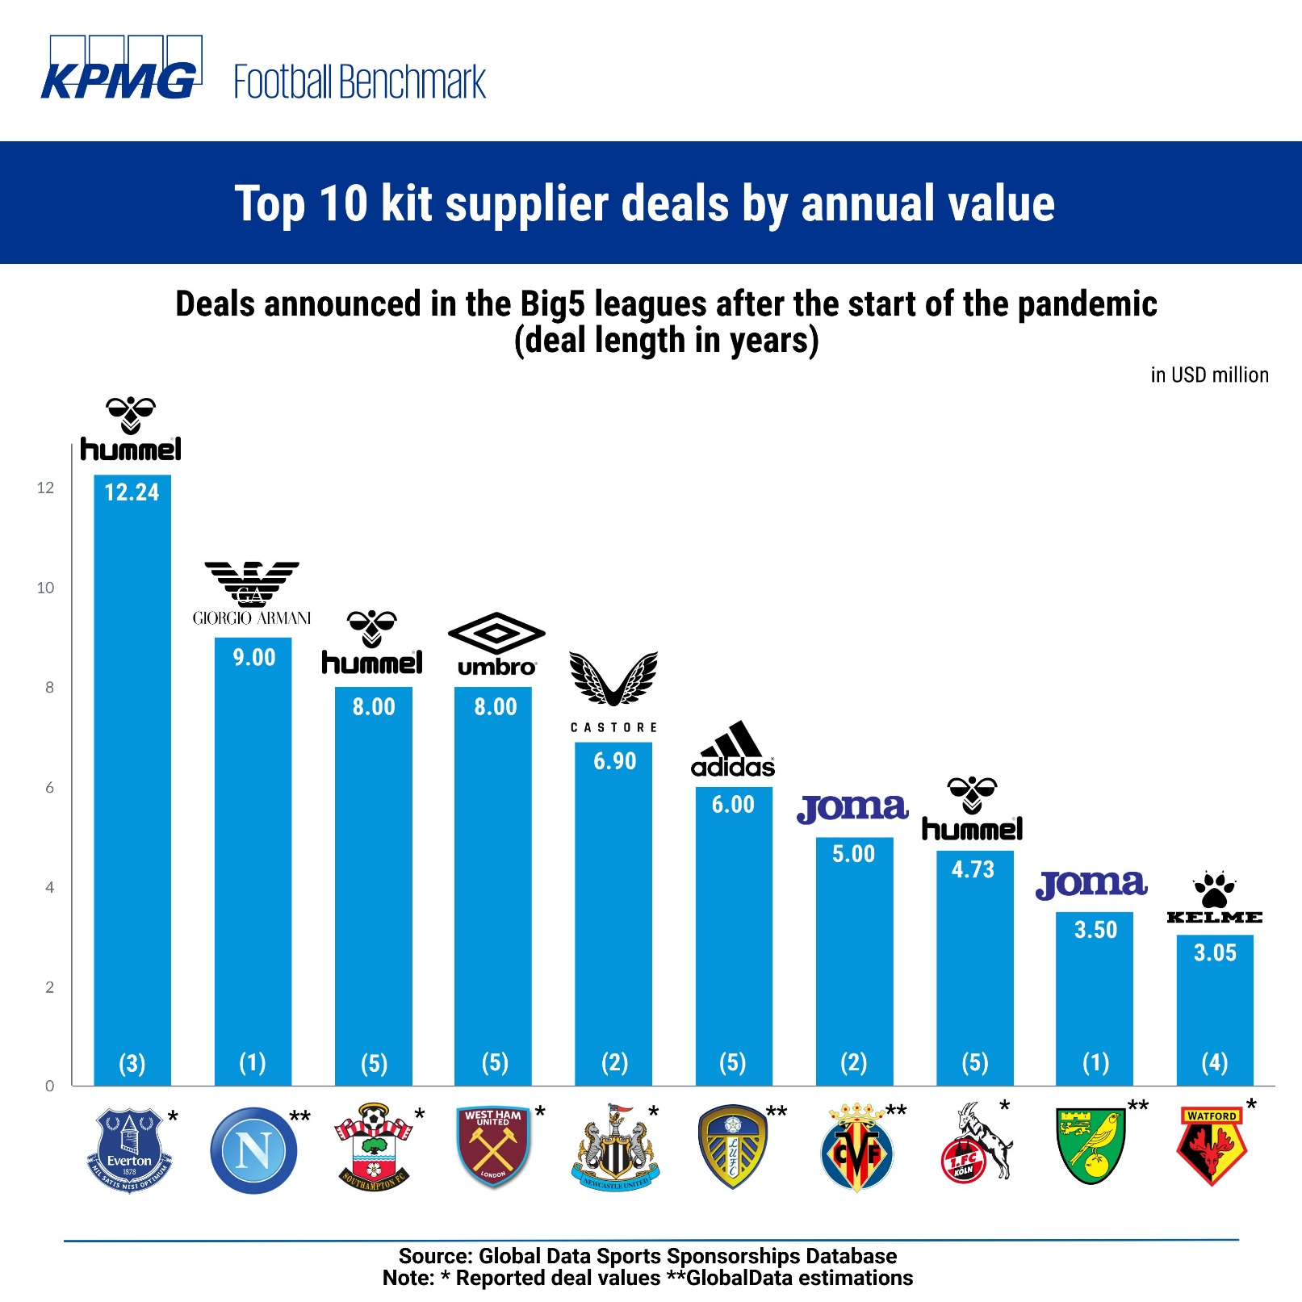

Slide 16
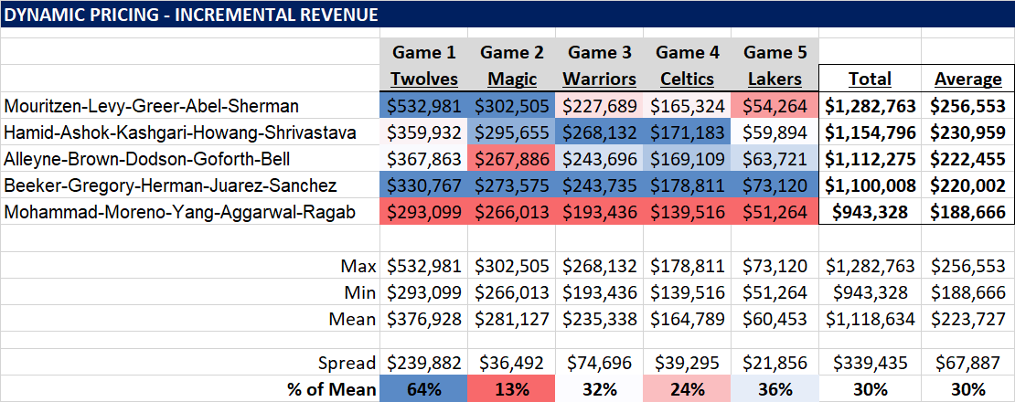
Assignment 2
Notes:
Automated – Alleyne, Mohammad

Slide 17
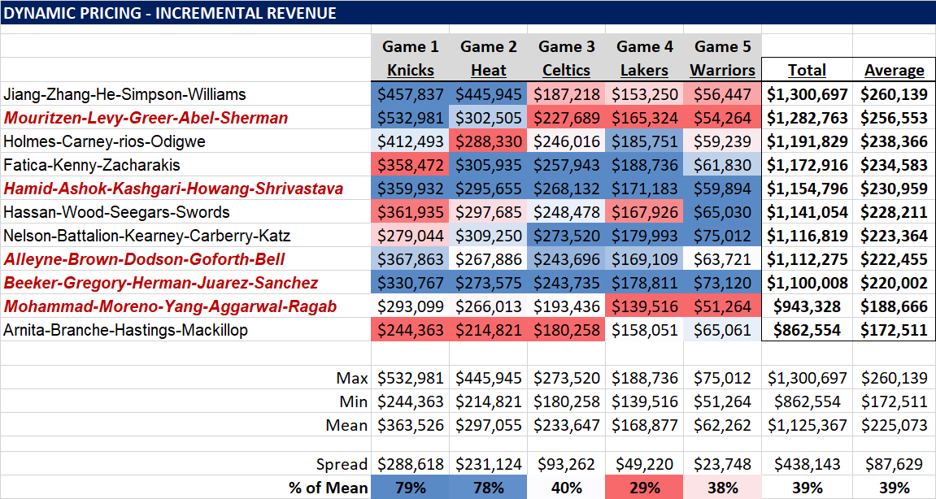
2021 vs. 2020 classes

Slide 18
Player Analytics
11/16 – Baseball |
11/23 – Soccer | Momin Ghaffar, Jaguars
11/30 – Basketball | Kevin Tenenbaum, Cle MLB
12/7 – Hockey | Oliver Miller-Farrell, Nash SC
KEY TAKEAWAYS:
How has the sport evolved: Basic vs. Advanced Stats
Offense vs. Defense
End-all Be-all | One all encompassing stat? WAR

Slide 19
Going beyond traditional stats – player evaluation
Baseball: HRs, RBIs, Runs, Wins, K’s, ERA
Other Sports:
Soccer/Hockey: Goals, assists, shots, saves
Basketball: Points, assists, blocks, rebounds, steals
Football: TDs, Yards, FGs, Int’s/Fumbles
Key Takeaways:
* Player evaluation stats are an evolving science
* Goal is to minimize risk
* Avoid paralysis through analysis

Slide 20
Baseball – 11.16.2021
The State of the Game: HRs & K’s, Defensive Shifts
Advanced Stats
WAR
SLG%, OBP, OPS
wOBA
UZR
Barrels
Outs Above Average
SecA
Assignment 3 – Due Nov. 29 | MLB GM

Slide 21
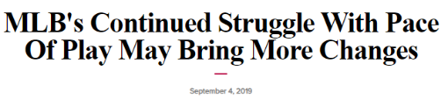
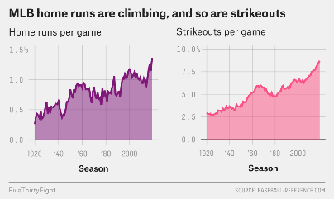
The State of the Game
The average time of a nine-inning MLB game has "once again reached 3 hours and 5 minutes, equaling the mark" set in '17, according to Gabe this season, mound visits were "reduced to five, and innings breaks in most games to two minutes, with Commissioner Rob Manfred set to unilaterally impose a three-batter minimum on relievers" in '20. Lacques of USA TODAY. That comes just one season after the average duration of a game "ticked back down to three hours." Before Hitters this season are "seeing an average" of 3.92 pitches per plate appearance, the "highest mark in the 21 seasons the stat has been tracked." There has also been a "record number of strikeouts -- 8.73 per team per game, shattering last year's mark of 8.48." That equals a "lot of time on the game clock before a ball's even put in play." While there is a "perception that the three-batter minimum will greatly reduce game times thanks to fewer mid-inning pitching changes, teams are using fewer pitchers per game this year (4.27) than last (4.36)."
2020 Rule Changes:
* Universal DH | 7 Inn. D-headers
* Runner on 2nd in Extra Innings
* Relievers face min 3 batters
= Avg. game time: 3h11m
Notes:
https://www.sportsbusinessdaily.com/Daily/Issues/2019/09/04/Leagues-and-Governing-Bodies/MLB.aspx

Slide 22
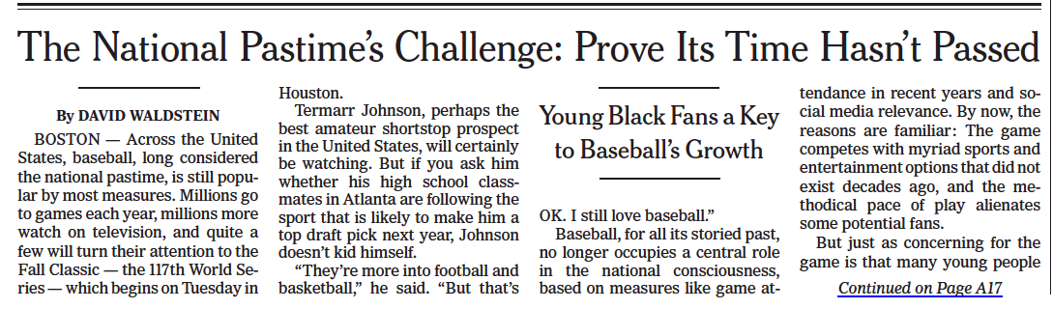
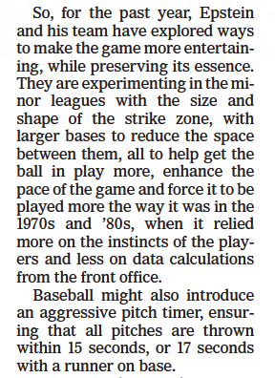
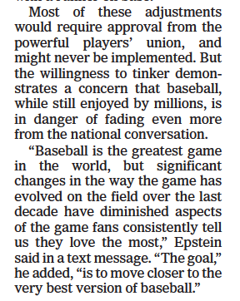
Notes:
NYT 10.25.2021

Slide 23
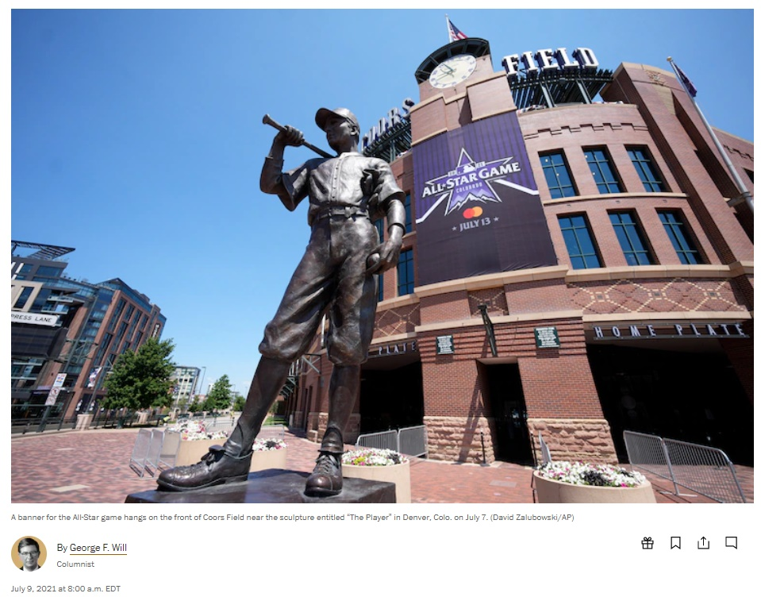
This April there were almost 1,100 more strikeouts than hits, and writer Tyler Kepner says this season is on a pace for approximately 5,000 more strikeouts than hits. Twenty-four percent of plate appearances end in strikeouts (they are increasing for the 16th consecutive season, partly because today’s average fastball’s velocity is 93.8 mph, 2.7 mph more than 14 years ago. As of mid-June, the .238 collective major league batting average was 15 points below 2019. In 2015, teams shifted infielders on 9.6 percent of all pitches. This season, teams are shifting on 32 percent (usually an infielder in shallow right field), which will erase perhaps 600 hits.
with 36 percent of at-bats ending with home runs, strikeouts or walks, around four minutes pass, on average, between balls put in play.
In 2021, there probably will be 1,000 fewer stolen bases than 10 years ago.
in the last 26 minutes of 2020’s most-watched game, the final World Series game, just two balls were put in play. In this game, the ball was put in play every 6.5 minutes, and half the outs were strikeouts.
Options: Move pitchers mound back. Require four infielders to be on the dirt, two on each side of 2B = reduce reliance on home runs (4 mins. of action)
20-second pitch clock
Notes:
https://www.washingtonpost.com/opinions/2021/07/09/time-has-come-save-baseball-by-changing-rules/?utm_source=SportTechie_Newsletter&utm_medium=Email&utm_campaign=SPRTCD210706002

Slide 24
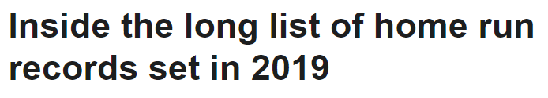
2019 HR Records:
6,776 total home runs (6,105, ‘17)
307 home runs by Twins (267, ‘18 NYY)
14 teams set franchise records
24 teams with 200-plus home runs (17, ‘17)
305 home runs given up by the Orioles (158, ‘17 Cincy)
53 home runs from one rookie slugger – Pete Alonso (52, ‘17 A.Judge)
273 players with double-digit home runs
13 home runs, in one game – 6/10 Ariz vs. Phi
1,228 in one calendar month – 6 months w 1,000+ (13 in MLB history)
74 home runs in one month ... by one team – NYY Aug. (58, ‘99 Sea)
31 straight games with a home run – NYY 5/26-7/2
114 five-homer games (60, ‘16)
1,937 team multi-homer games (1,703, ‘17)
NYY – most HRs (61) vs. one opponent – Orioles (48, ‘56 NYY-KC) – Gleyber Torres (13)
Notes:
https://www.espn.com/mlb/story/_/id/27731274/inside-long-list-home-run-records-set-2019

Slide 25
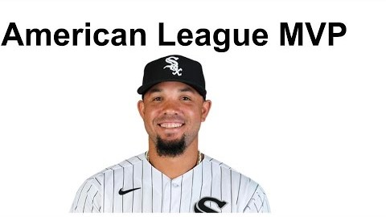
2020 Season in Review
Notes:
https://www.youtube.com/watch?v=J2y84GigBEs

Slide 26
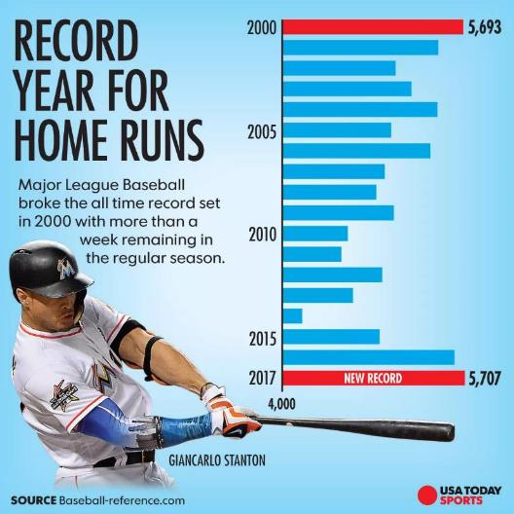
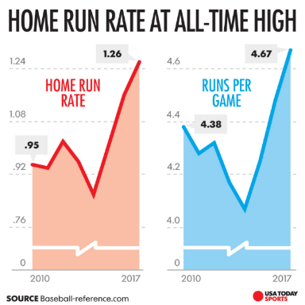
2017 – The Year of the Home Run
2018: 5,585 – 4th Highest
AL: 2,900 – 2nd Highest
Playoffs Record: 101 (‘04: 100)
World Series Records: 22 (’02: 21) | 7 in Game 5
Notes:
https://www.usatoday.com/story/sports/mlb/2017/09/19/new-mlb-home-run-record/683559001/

Slide 27
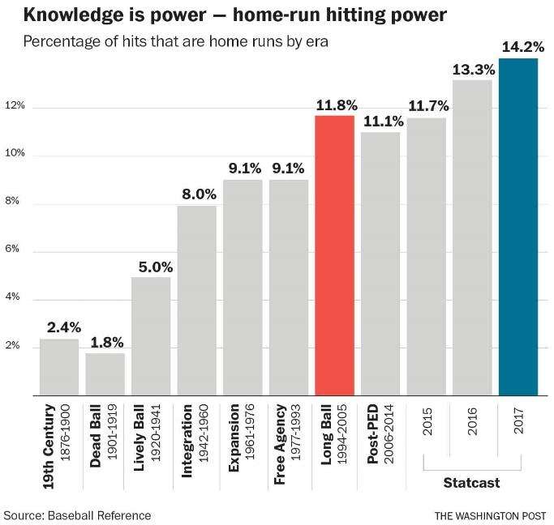
Notes:
https://elitesportsny.com/2017/06/21/new-york-mets-need-hit-home-runs-plan-contending/

Slide 28
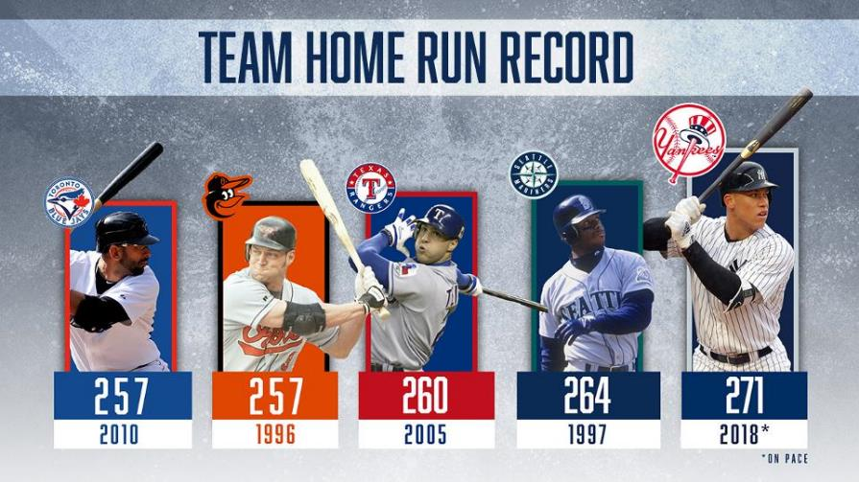
2018 – NYY sets record with 267 HRs
First team ever with 20-plus home runs out of every batting order position
Notes:
https://www.mlb.com/news/most-home-runs-by-a-team-in-one-season/c-296317932

Slide 29
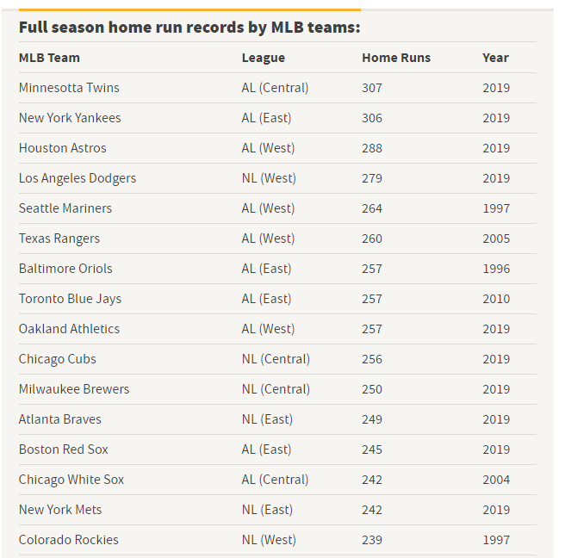
Notes:
https://en.as.com/en/2021/10/02/mlb/1633177596_848408.html

Slide 30
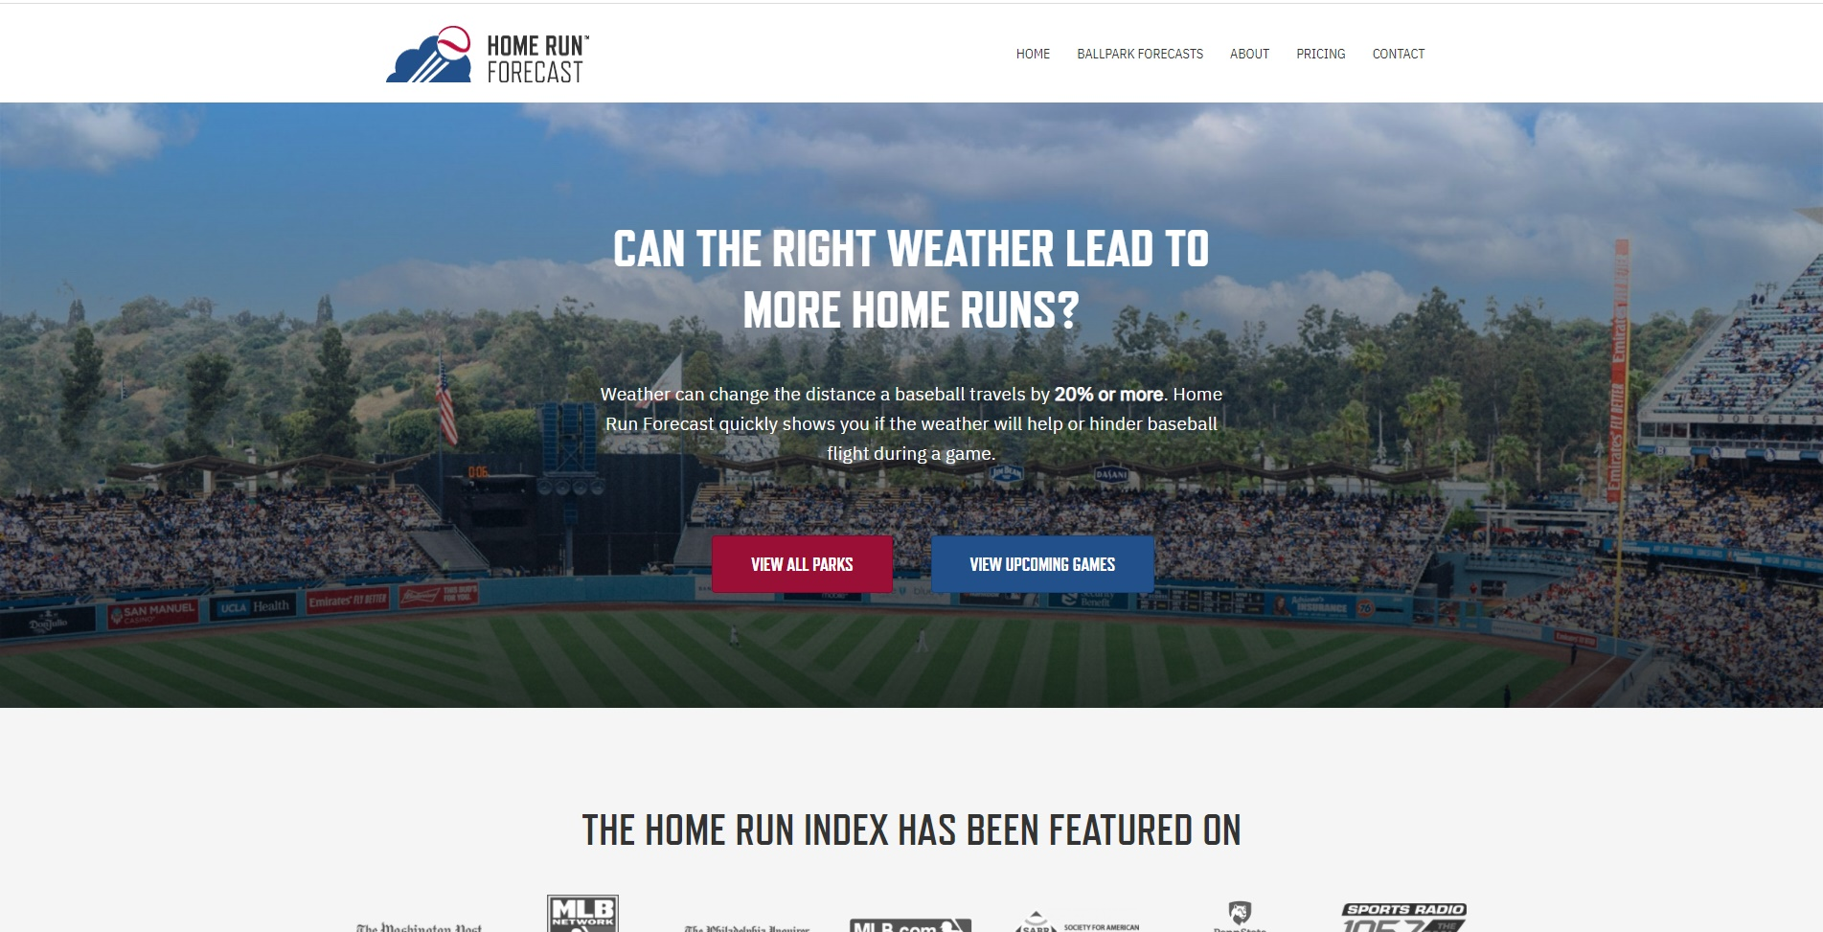
https://www.homerunforecast.com/

Slide 31
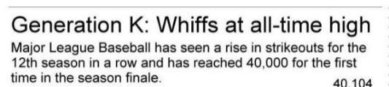
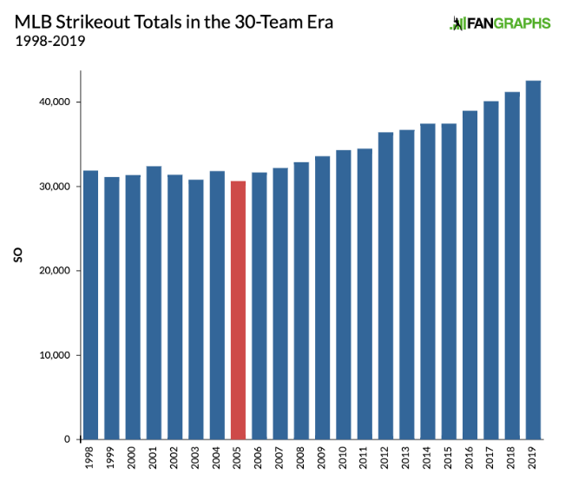
Notes:
http://bangordailynews.com/2017/10/03/sports/baseball/home-runs-strikeouts-hit-highs-no-pitcher-wins-more-than-18/
https://www.sbnation.com/2017/10/25/16545300/2017-was-the-year-of-the-immaculate-inning-in-mlb-this-is-why

Slide 32
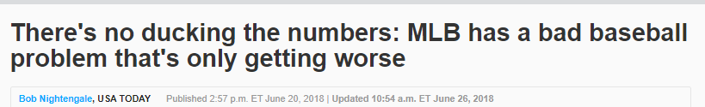
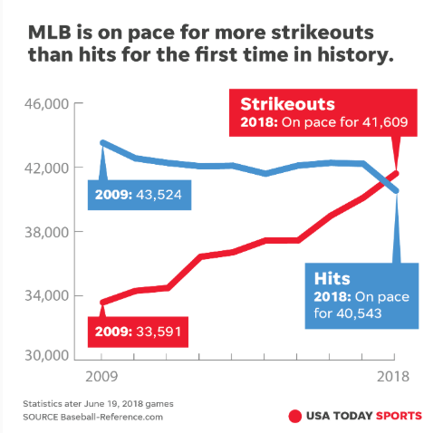
?
Notes:
https://www.usatoday.com/story/sports/mlb/columnist/bob-nightengale/2018/06/20/mlb-bad-baseball-attendance-strikeouts/718162002/

Slide 33
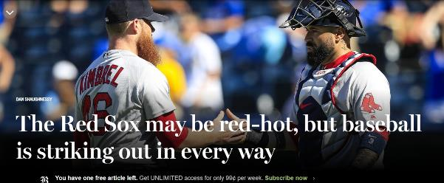
Baseball has become the sanctuary of senior citizens. Hardcore baseball fans are the same people who have land lines in their home and still read daily newspapers. Anybody seen my Sporting News?
Pace of play has made the game largely unwatchable on television.
Strikeout inflation is a big part of the problem.
This will be the 11th consecutive season in which MLB sets a record for strikeouts.
Analytics are out of control. Even commissioner Rob Manfred agrees. Manfred recently told The Athletic, “There is a growing recognition that analytics have produced certain trends in the game that we may need to be more proactive about reversing. There are owners that feel that way. There are fans that feel that way.’’
Notes:
https://www.bostonglobe.com/sports/redsox/2018/07/08/the-red-sox-may-red-hot-but-baseball-striking-out-every-way/6gq0GyH9X01dtuJQZgblAM/story.html

Slide 34
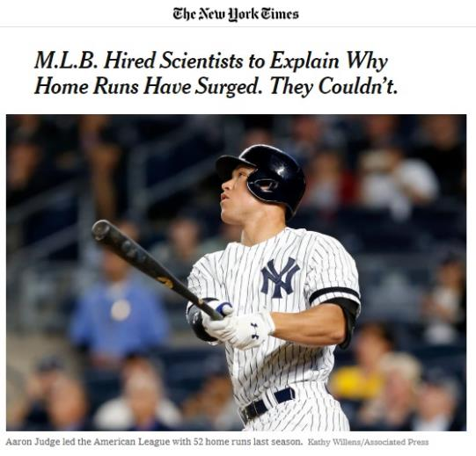
Studied 37 dozen new/game-used balls
Ruled out:
* Coefficient of Restitution or the bounciness of the baseball, had not changed.
* notion that the slugging surge was caused by batters’ altering their approach by swinging with a more upward motion (launch angle)
* swinging harder; or trying to pull the ball more.
Instead, the study determined that the change occurred once the ball was in the air. The researchers found some undetermined changes in the aerodynamic properties of the baseball, progressing steadily from 2015 to 2017, had resulted in a small decrease in the average drag coefficient of the ball.
Notes:
https://www.nytimes.com/2018/05/24/sports/major-league-baseball-study.html

Slide 35
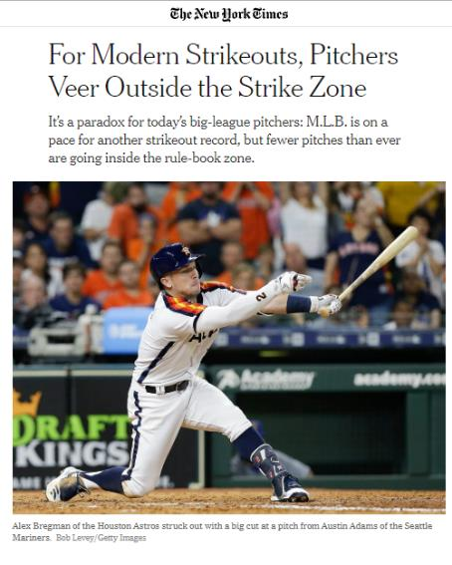
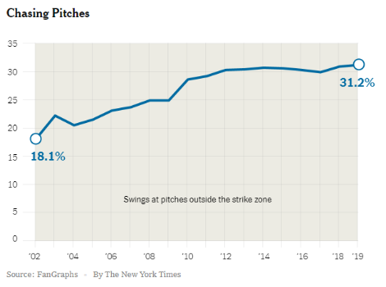
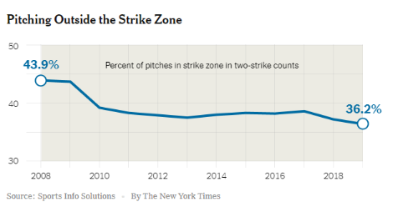
Video examples:
https://www.nytimes.com/2019/07/16/sports/baseball/mlb-strikeouts.html
Notes:
https://www.nytimes.com/2019/07/16/sports/baseball/mlb-strikeouts.html

Slide 36
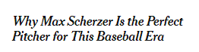
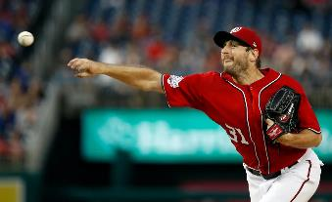
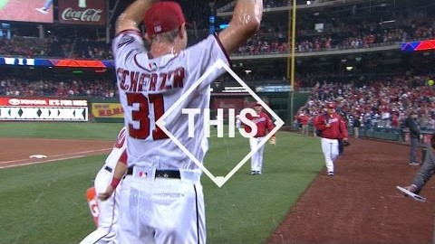
In 1984, the year Max Scherzer was born, just two qualified pitchers averaged a strikeout per inning. This year, through Wednesday, there were 31.
He is averaging 14.25 strikeouts per nine innings, which would be a record for a full season.
Recorded 300thK. 17th pitcher to do so
Scherzer is the leader in victories and strikeouts in the decade of the 2010s
The vexing issue for baseball, as it tries to capture a younger generation craving action, is that pitchers of all pedigrees are keeping the ball out of play. Asked if he and his fellow pitchers were simply too good — more dominant for shorter bursts — Scherzer said no
Notes:
https://www.nytimes.com/2018/05/24/sports/max-scherzer-washington-nationals.html
https://www.youtube.com/watch?time_continue=10&v=hWt6o0_1hx0

Slide 37
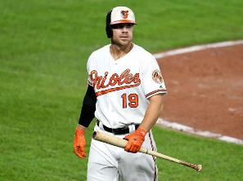
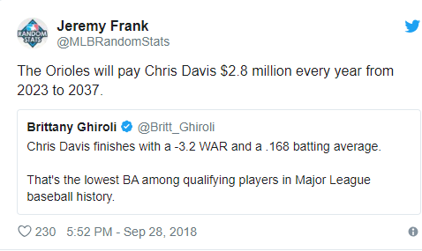
Orioles' $161 million man finishes season with worst batting average in MLB history
To be considered a qualified hitter, a batter must reach 502 plate appearances in a given season. That averages out to 3.1 plate appearances per team game. Davis is at 522.
There’s no way around it. It’s the literal worst season we’ve ever seen from a big league hitter, and it comes just three years into Davis’ massive seven-year contract.
BA - ‘18: .168 | ‘19: .179 | ‘20: .115
7-year $23M/yr deal signed in 2016 = 2 years remaining
Notes:
https://sports.yahoo.com/orioles-161-million-man-finishes-worst-batting-average-mlb-history-165415933.html

Slide 38
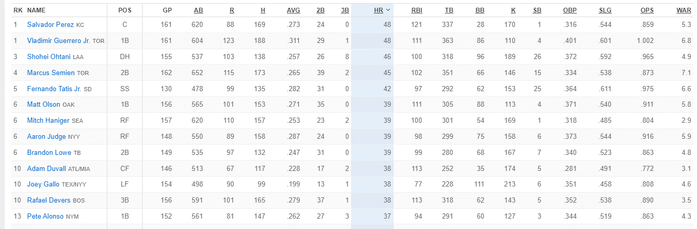
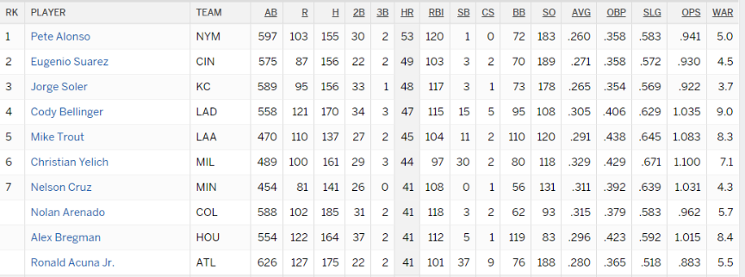
All or Nothing: HRs & K’s
2021
2019
Notes:
https://www.espn.com/mlb/stats/player/_/view/batting/season/2021/seasontype/2/table/batting/sort/homeRuns/dir/desc

Slide 39
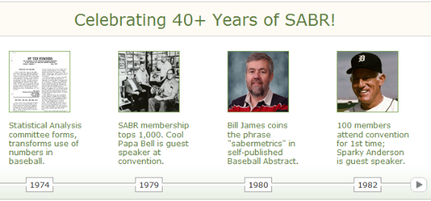
SABR
Society for American Baseball Research (1971)
Scientifically analyzes baseball via statistical data to determine why teams win and lose
6,000 members – mostly plain fans. Anyone can join
The Baseball Research Journal (BRJ) is SABR's flagship publication. Established in 1972, BRJ was created so that members could publish and share their research with like-minded students of baseball. Today, BRJ provides a unique mix of cutting-edge baseball research and historical and biographical articles.
Notes:
http://sabr.org/about

Slide 40
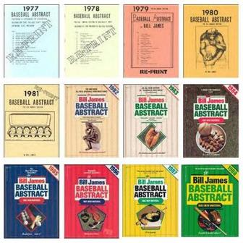
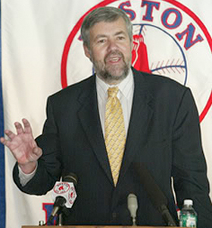


Baseball Analytics/Sabermetrics
Bill James
The Baseball Abstract
Est. 1977
Moneyball: The Art of Winning an Unfair Game
By, Michael Lewis
2004

Slide 41




Notes:
https://deadspin.com/everyones-mad-at-bill-james-for-being-an-old-dummy-1830316456

Slide 42

Moneyball the movie (2011)
Notes:
https://www.youtube.com/watch?v=yGf6LNWY9AI

Slide 43


Fangraphs.com (2005)
Notes:
https://www.washingtonpost.com/news/sports/wp/2016/02/15/the-rise-of-fangraphs-stats-site-gives-fans-front-offices-view-to-baseballs-evolution/

Slide 44

Baseball stats
Traditional: HRs, RBIs, Runs, Wins, K’s, ERA
Modern: WAR
Offense (40): OPS, wOBA, UBR, wRC, BABIP
Defense (20): UZR, DRS, rSB
Pitching (45): WHIP, FIP, F-Strike %
Notes:
http://www.fangraphs.com/library/fangraphs-library-glossary/

Slide 45


WAR – Wins Above Replacement
WAR = (Batting Runs + Base Running Runs +Fielding Runs + Positional Adjustment + League Adjustment +Replacement Runs) / (Runs Per Win)
An attempt by the sabermetric baseball community to summarize a player’s total contributions to their team in one statistic: ~replacement value
2019: 18 players at 6.0+ WAR

Slide 46




2019/2021 WAR leaders
= MVP
2020
2021 {MVPs – Thur 11/18}
Notes:
https://www.baseball-reference.com/leagues/majors/2021-batting-leaders.shtml

Slide 47




2019-20 WAR leaders: Offense vs. Defense
= MVP
2020
2021
Notes:
http://www.baseball-reference.com/leagues/MLB/2018-batting-leaders.shtml

Slide 48


WAR – 2012-19
Notes:
http://www.fangraphs.com/blogs/the-kyle-seager-appreciation-article/

Slide 49



Notes:
https://www.nytimes.com/interactive/2019/02/20/sports/baseball/free-agent-big-contracts.html

Slide 50


Assignment 3 – Due 11/28
https://www.fangraphs.com/

Slide 51




Notes:
https://www.si.com/mlb/2021/11/08/mlb-free-agent-rankings-predictions-correa-seager-scherzer

Slide 52



Slugging %, OBP & OPS
Slugging %: Total Bases / At Bats
Extra weight given to extra-base hits
All extra-based hits weighed equally
OPS: On-base Plus Slugging
OBP: Value based on # of times reaching base, not just hits (BA)

Slide 53
OPS+
Definition
OPS+ takes a player's on-base plus slugging percentage and normalizes the number across the entire league. It accounts for external factors like ballparks. It then adjusts so a score of 100 is league average, and 150 is 50 percent better than the league average.
For example, Miguel Cabrera's .895 OPS in 2014 was 50 percent better than the MLB average after being adjusted for league and park factors. As a result, his OPS+ was 150.
The formula
(OPS / league OPS, adjusted for park factors) x 100
Why it's useful:
OPS is a solid tool for evaluating a player's performance at the plate, but OPS+ is a more accurate barometer for those interested in a number that is not affected by individual parks or leagues.
Fantasy advantage
This can be a good tool for ranking players who may have switched teams, because OPS+ adjusts for park and league. Otherwise, for fantasy purposes, OPS is a more useful stat.
Notes:
http://m.mlb.com/glossary/advanced-stats/on-base-plus-slugging-plus

Slide 54



OPS: TOP 20 in 2021
{1}
{18}
{11}
{2}
{5}

Slide 55



= MVP
OPS: TOP 20 in 2020
{10}
{15}
{2}
{4}

Slide 56

wOBA – weighted On-Base Average
wOBA is based on a simple concept: Not all hits are created equal. Slight adjustments by season. Looks to credit a hitter for the value of each outcome.
The wOBA formula for the 2017 season was:
The wOBA formula for the 2013-16 seasons was:
wOBA = (0.690×uBB + 0.722×HBP + 0.888×1B + 1.271×2B + 1.616×3B + 2.101×HR) / (AB + BB – IBB + SF + HBP)
Notes:
http://www.fangraphs.com/library/offense/woba/

Slide 57


wOBA – weighted On-Base Average
Rules of Thumb
Rating | wOBA
Excellent | .400
Great | .370
Above Average | .340
Average | .320
Below Average | .310
Poor | .300
Awful | .290
Notes:
http://www.fangraphs.com/library/offense/woba/

Slide 58

2021 wOBA leaders

Slide 59


2020 wOBA leaders
= MVP

Slide 60


2015-2019 wOBA leaders

Slide 61



Notes:
https://www.washingtonpost.com/sports/2019/05/14/bryce-harper-phillies-slump/

Slide 62

SABR – impact on Gold Glove Award
Traditional Criteria:
Gold Glove Award (1957)
* 18 winners: 1 per position in each league
* Decided by voting managers & coaches (up to 6 per staff; cannot vote for own players)
* Criteria: players judged to have exhibited superior individual fielding performances
Silver Slugger Award (1980)
* Coach/Manager vote
* Stats considered: BA, SLG, OBP + general impression of overall offensive value
Notes:
http://sabr.org/latest/new-sabermetric-component-revealed-rawlings-gold-glove-award

Slide 63


2013
SDI will account for 25% of award determinant
The SDI is built from two types of defensive metrics:
Those that come from batted ball location-based data
70% weighting
degree to which a fielder makes plays in specific zones on the diamond in comparison to a player’s peers
Defensive Runs Saved (DRS), Ultimate Zone Rating (UZR), Runs Effectively Defended (RED)
Those which originate from the play-by-play records of games
30% weighting
estimates the number of batted balls hit into a fielder's area
Defensive Regression Analysis (DRA), Total Zone Rating (TZ)
“While fielding is perhaps the ultimate art form in baseball, SABR is proud to partner with Rawlings and the iconic Rawlings Gold Glove Award to introduce ‘science’ into the Rawlings Gold Glove Award criteria.” – Vince Gennaro, SABR President

Slide 64

UZR – a closer loook
Ultimate Zone Rating (UZR)
Created by sabermetician Michael Lichtman
Field is split into 78 different slices/zones
Average # of balls in play in each zone & rate at which plays made are recorded in each zone = baseline avg for each position
Players rated against league average: player who records more outs in zone than an avg defender = positive zone rating
UZR/150 – per 150 games
Notes:
http://www.blessyouboys.com/2010/1/9/1240320/saber-101-ultimate-zone-rating

Slide 65
SDI – Elements measured
Overall: fielder's range & his throwing arm/sure-handedness
SS/2B: ability to turn double-plays
P/C/3B/1B: ability to convert bunts into outs
1B: scoops of throws in the dirt
number of "excellent" and "poor" fielding plays. I
OF: ability to prevent runners from taking an extra
C: blocking balls in the dirt and stolen bases/caught stealing are also included in their ratings.
P: ability to control the running game by holding runners on base
Pitch framing by catchers is not currently included in the defensive metrics that comprise the SDI

Slide 66


2021 SABR Defensive Rankings & Gold Glove Award Winners (Bold)
Notes:
https://sabr.org/sdi/2021-final

Slide 67

2020 Gold Glove Winners – announced 11.3.20
Due to the compressed 2020 season, the Award qualifications have been amended to rely solely on the SABR Defensive Index™ (SDI).
Notes:
https://sabr.org/sdi/2020-final
https://www.mlb.com/news/2020-gold-glove-finalists
Due to the compressed 2020 season, the Award qualifications have been amended to rely solely on the SABR Defensive Index™ (SDI). To be considered, pitchers must have pitched at least 50 innings, catchers must have played in at least 29 games and infielders/outfielders must have completed at least 265 defensive innings. Each player qualifies at the position he has played at most (SDI is only for play at qualified position).

Slide 68


New Statcast data pays dividends for Tampa’s Kevin Kiermaier – 6 year $53.5M contract extension
For Defense, not offense.
Career BA .258, few HRs
Since ‘04: Best in Defensive Runs Saved (DRS) and Ultimate Zone Rating (UZR)
Catch Probability expresses the likelihood for a ball to be caught by an outfielder based on opportunity time, distance needed, and direction.
Outs Above Average (OAA) is the cumulative effect of all individual Catch Probability plays a fielder has been credited or debited with making it a range-based metric of fielding skill that accounts for the number of plays made and the difficulty of them.
Notes:
https://www.nytimes.com/2017/04/17/sports/baseball/baseballs-data-revolution-is-elevating-defensive-dynamos.html?_r=1

Slide 69


Notes:
http://m.mlb.com/glossary/statcast/catch-probability
https://www.youtube.com/watch?v=DhJxYeDUbLQ

Slide 70


Impact of Defensive Data Explosion - 2014

Slide 71



2014 – The Year of the Shift
“None of the stuff that’s come up the last several years has benefited offense,” said Joe Maddon, the manager of the Tampa Bay Rays. “It’s actually subtracted from offense, and it’s going to continue to subtract. Offense is going to go back almost to the dead-ball era.
1972, year prior to DH
Notes:
http://espn.go.com/mlb/story/_/id/11060210/defensive-shift-used-all-mlb-teams-espn-magazine
http://www.billjamesonline.com/who_gives_a_shift_/
https://sg.sports.yahoo.com/photos/graphic-looks-total-mlb-shifts-season-top-five-photo-071830432--spt.html
http://www.nytimes.com/2014/07/04/sports/baseball/hitters-in-mlb-this-season-have-struggled-at-historic-rates.html

Slide 72

Shift proves costly in 2015 NLDS: NYM wins Game 5 vs. LAD
http://m.mlb.com/video/topic/94785582/v523357883/must-c-crafty-murphy-takes-two-bases-on-walk-scores
Notes:
https://www.youtube.com/watch?v=ncX3q7mQf7s
Fifth and deciding game. Mets win 3-2

Slide 73


Slide 74



Baseball’s “Moneyball” era has brought drastic changes in how managers handle their pitching staffs and where they position players on the field. Armed with newly revealing statistical analysis, scouts assess players differently, and fans view the game differently.
The latest frontier in baseball’s number-crunching revolution might be the dimensions of the field itself.
If the new contours produce a net advantage for the Mets next season, Ian Levin, the team’s 30-year-old manager of baseball analytics, might deserve as much credit as their hitters.
Notes:
http://www.nytimes.com/2014/11/19/sports/baseball/mets-fences-citi-field.html?action=click&contentCollection=Baseball&module=RelatedCoverage&region=Marginalia&pgtype=article
Team reports that 27 more HRs would have been hit in 2014, 17 of which by the Mets. Curtis Granderson (20 HRs) would have had 9 additional HRs

Slide 75


Notes:
http://www.fangraphs.com/library/misc/pitch-fx/

Slide 76


Statcast, a state-of-the-art tracking technology, is capable of measuring previously unquantifiable aspects of the game.
Set up in all 30 Major League ballparks, Statcast collects data using a series of high-resolution optical cameras along with radar equipment. The technology precisely tracks the location and movements of the ball and every player on the field, resulting in an unparalleled amount of information covering everything from the pitcher to the batter to baserunners and defensive players.
https://twitter.com/statcast
Notes:
http://m.mlb.com/glossary/statcast
http://m.mlb.com/news/article/119234412/statcast-primer-baseball-will-never-be-the-same/

Slide 77


Weighted Runs Created/WRC+
The Phillies need Dillon’s help. The Nationals’ offense ranked eighth in the majors this season, according to one of their favorite advanced metrics, weighted runs created, while the Phillies ranked 21st. The simple statistics bear that out too — the Phillies scored nearly 100 runs fewer than the Nationals’ 873 despite the Phillies having talent in their lineup with J.T. Realmuto, Rhys Hoskins and Bryce Harper.
Notes:
https://www.washingtonpost.com/sports/2019/11/21/nationals-assistant-hitting-coach-joe-dillon-departs-phillies/

Slide 78




Slide 79

https://baseballsavant.mlb.com/
Notes:
https://baseballsavant.mlb.com/

Slide 80


Notes:
http://m.mlb.com/glossary/statcast/barrel

Slide 81


THE BARREL ZONE
Accounts for nearly all HR’s, 1/3 of doubles and triples
http://m.mlb.com/news/article/201699298/new-statcast-metric-barrels-has-best-hit-balls/
Notes:
http://m.mlb.com/news/article/201699298/new-statcast-metric-barrels-has-best-hit-balls/

Slide 82



Utilizing Advanced Data to change the game/increase HR’s
Notes:
https://www.fangraphs.com/community/using-statcast-data-to-predict-future-results/

Slide 83

STATCAST LEADERBOARD - OFFENSE
Joey Gallo: #1 in 2018 {11.4} | Aaron Judge: #1 in 2017 {12.8}
Brls/PA: % of Barrels per Plate Appearance

Slide 84

STATCAST LEADERBOARD - DEFENSE
Harrison Bader: #1 in 2018 {21}
Notes:
https://baseballsavant.mlb.com/outs_above_average

Slide 85


MEDICAL/FITNESS DATA – THE NEXT FRONTIER
With 1,030 games lost by Nats players to injury according to the ManGamesLost website, it became apparent the Nats weren’t moving in the right direction. Part of the problem centered on off-season workout regimens
Injuries devastated the A’s this year. They set an Oakland record by using the disabled list 27 times and by losing 1,762 days of player availability.
Notes:
http://www.sfgate.com/athletics/article/Sports-science-technology-might-help-reduce-A-s-9410565.php

Slide 86

On-screen graphics on Root Sports SW prior to each Astros game "include BABIP and FIP along with ERA and win-loss records plus pitch percentages.
Notes:
http://www.houstonchronicle.com/sports/texas-sports-nation/article/There-s-a-stat-for-that-Astros-weave-modern-data-11187120.php
http://www.sportsbusinessdaily.com/Daily/Issues/2017/06/02/Media/Astros

